Slide 1

LEARNING REPRESENTATION OF NODES IN SIGNED SOCIAL NETWORK BY ASHWIN SINGH (17CS60R45) BRITI GANGOPADHYAYA (17AT61R09) MENTOR: AYAN KUMAR BHOWMICK
UNDER PROF. BIVAS MITRA
DEPARTMENT OF COMPUTER SCIENCE AND ENGINEERING
INDIAN INSTITUTE OF TECHNOLOGY
KHARAGPUR

Slide 2
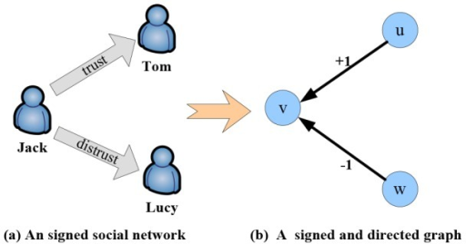
INTRODUCTION
+1
A
-1
A
B
B
A_{status}<B_{status}
A_{status}>B_{status}
STATUS VECTOR : [ incoming +ve links/total degree,
outgoing +ve links/total degree,
incoming –ve links/total degree,
outgoing –ve links/total degree]

Slide 3
PROBLEM STATEMENT
To develop a new embedding algorithm using status vector similarity among the nodes using symmetrical deep auto encoders.
To evaluate the embedding in terms of link prediction and node clustering with respect to the baselines SIDE, SiNE and SNE.

Slide 4
INPUT MATRIX
A N X N matrix where N is the number of nodes in the network
Aij = 1 if the link between i to j is positive
Aij = 0 if the link between i to j is negative
Aij = similarity value obtained from cosine similarity of i and j if i and j are disconnected
C
 | A | B | C | D | E
A | 1 | 0 | 1 | 0.21 | 1
B | 1 | 1 | 0.23 | 0.53 | 1
C | 0.43 | 0.15 | 1 | 0.12 | 0.45
D | 0 | 0.21 | 0.12 | 1 | 0.10
E | 1 | 0.13 | 0.51 | 0.12 | 1
+1
-1
A
+1
B
-1
+1
D
+1
E

Slide 5
ARCHITECURE
Output Layer
Input Layer
A1
A2
A3
A4
A5
.
.
.
.
.
.
.
.
An
A1
A2
A3
A4
A5
.
.
.
.
.
.
.
.
An
Hidden Layer 1
Hidden Layer 2
Sigmoid
Sigmoid
Embedding
Encoder
Decoder

Slide 6
PARAMETERS
Input : Matrix A [ Each row i of matrix A is a feature vector for node I ]
Number of Hidden Layers = 2 Hidden Layer 1 dimension : 256 Hidden Layer 2 dimension : 128
Learning rate : 0.01
Activation function : Sigmoid
Loss Function : RMSE ( β*loss if +ve connection between nodes 1/ β*loss if –ve connection between nodes)

Slide 7
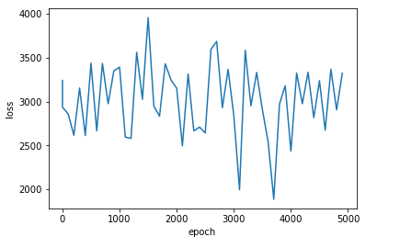
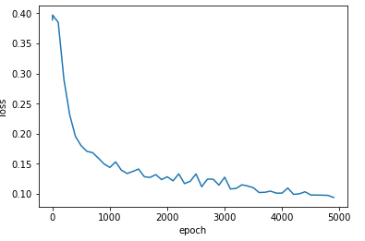
TRAINING LOSS
LOSS with similarity
matrix
LOSS with modified similarity matrix

Slide 8
NODE CLUSTERING
The nodes are clustered based on status vector and certain threshold
(Incoming +ve)+(outgoing +ve) > 0.7 cluster 1
(Incoming -ve)+(outgoing -ve) > 0.7 cluster 2
Otherwise cluster 3 (behaviour unknown)
For embedding vector we have used k-means clustering
A
+1
B
-1
-1
+1
C

Slide 9
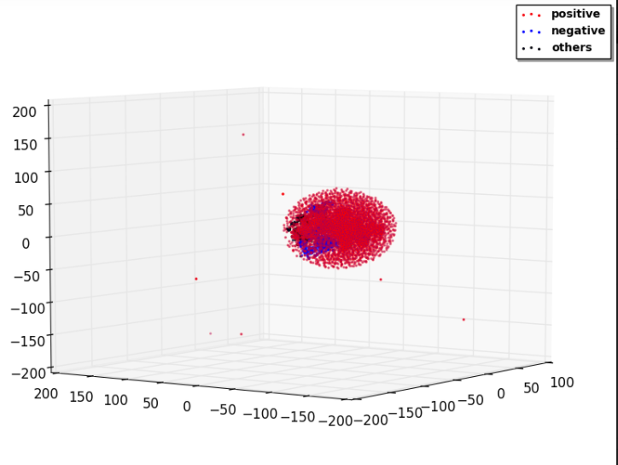
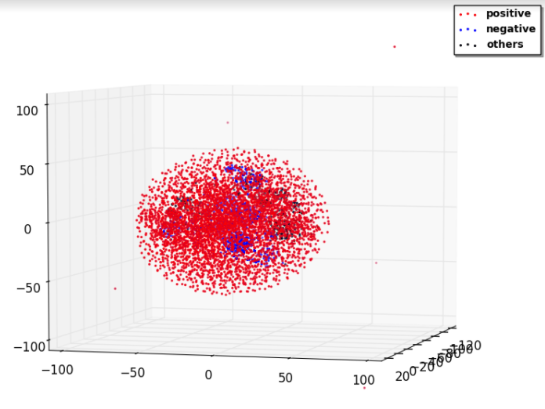
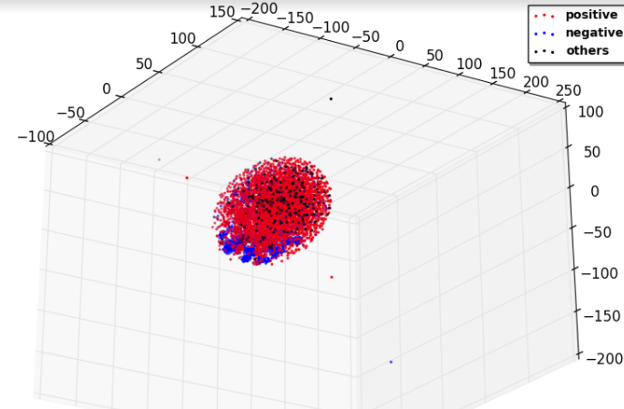
EMBEDDING VISUALIZATION BASELINES
SIDE VISULIZATION
SiNE VISULIZATION
SNE VISULIZATION

Slide 10
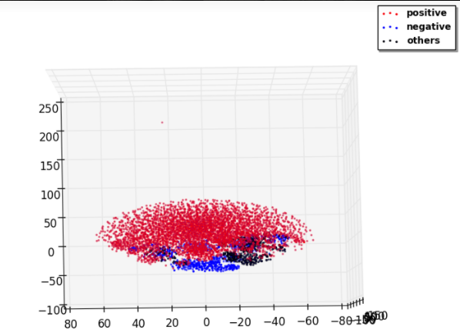
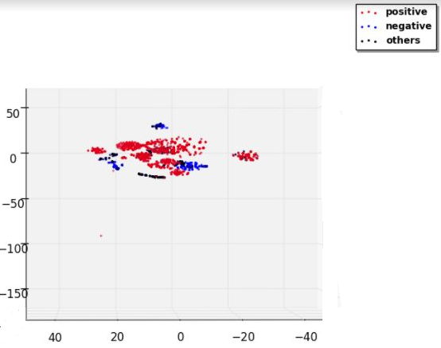
EMBEDDING VISUALIZATION PROPOSED METHOD

Slide 11
RESULT
 | SIDE | SNE | SiNE | Propose Algorithm
Precision | 0.78 | 0.76 | 0.72 | 0.90
Recall | 0.52 | 0.60 | 0.58 | 0.89
F-Score | 0.624 | 0.67 | 0.64 | o.89
NMI | 0.0024 | 0.0025 | 0.0021 | 0.36

Slide 12
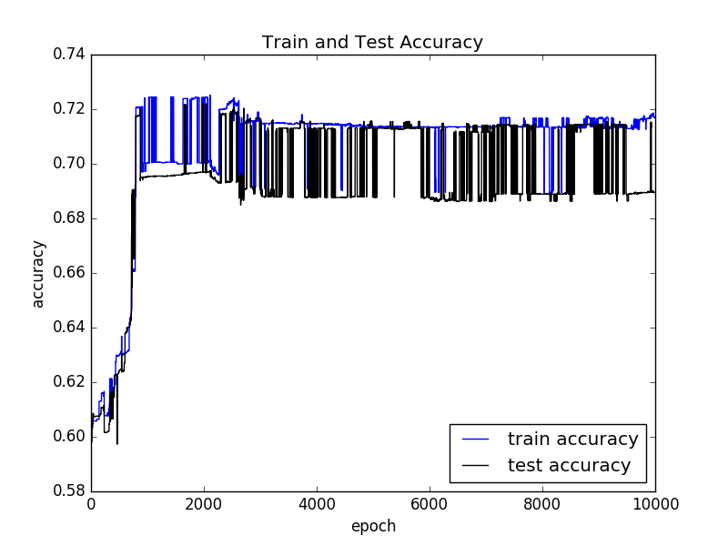
LINK PREDICTION
Node Vector to Edge Vector :
Prediction Result :
Operator | Definition
Hadamard | e_{uv} = v_{u} ∗ v_{v}
AUC | SIDE | SNE | SiNE | Propose Algorithm
Wikipedia 2 | 0.901 | 0.762 | 0.790 | 0.73

Slide 13
CONCLUSION
1) We were able to successfully capture the behavioural aspect of the network in the embedding and predict clusters which performed better than the baselines.
2) Link prediction did not perform better than the baselines since the embedding is not preserving the structural aspect of the network.

Slide 14
REFERENCES
Shuhan Yuan, Xintao Wu, and Yang Xiang. 2017. SNE: Signed Network Embedding. In Pacic-Asia Conference on Knowledge Discovery and Data Mining.Springer, 183–195.
Junghwan Kim, Haekyu Park, Ji-Eun Lee, and U Kang. SIDE: Representation Learning in Signed Directed Networks, Seoul National University, Seoul, Korea
Suhang Wang, Jiliang Tang, Charu Aggarwal, Yi Chang, Huan Liu, Signed Network Embedding in Social Media
Shaosheng Cao, Wei Lu, and Qiongkai Xu. 2016. Deep neural networks for learning graph representations. In Proceedings of the irtieth AAAI Conference on Articial Intelligence. AAAI Press, 1145–1152.

Slide 15
THANK YOU

